Slide 1



Luhn Algorithm
CS 131
Arthur Lazaryan

Slide 2
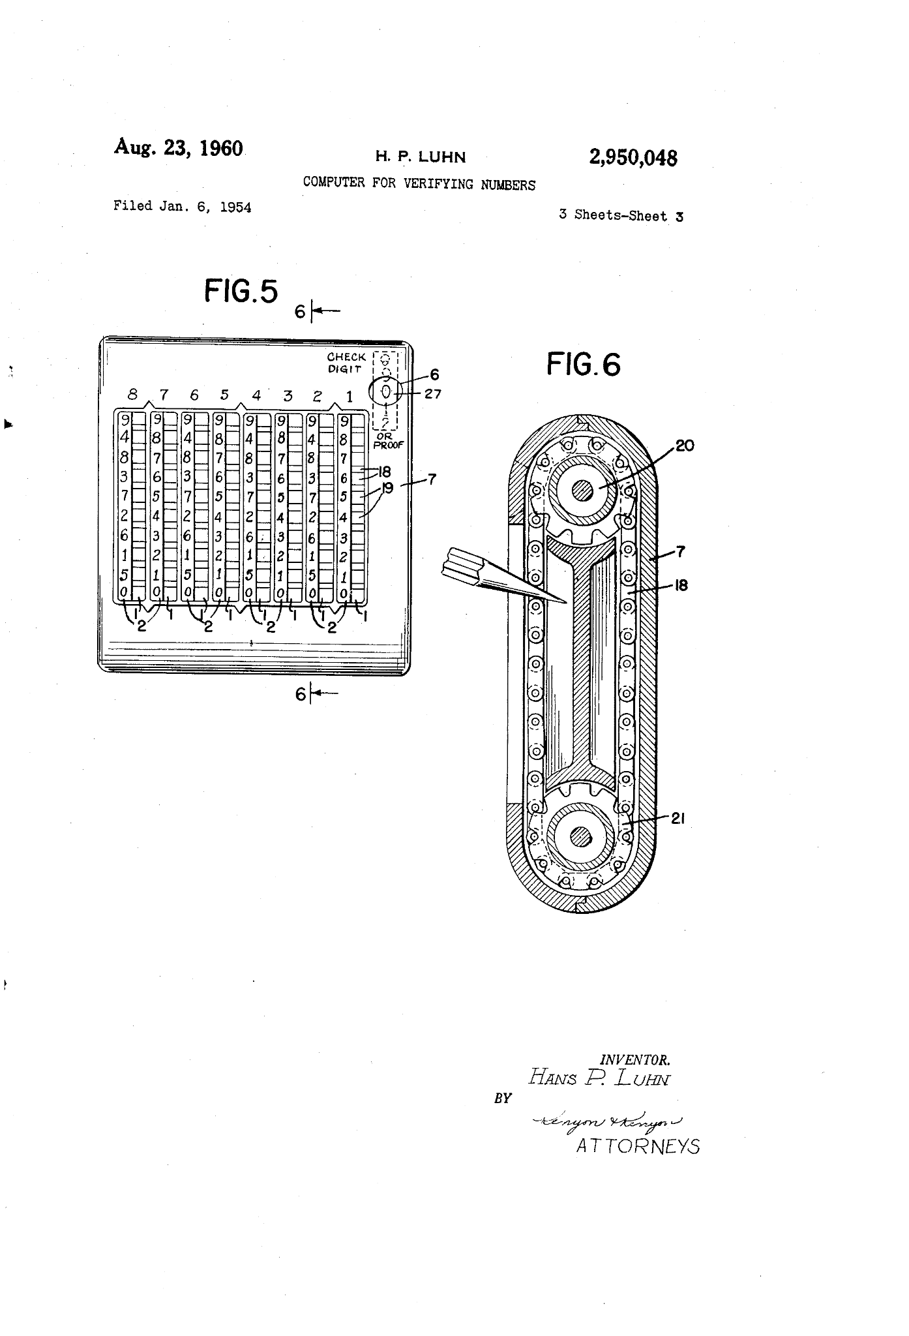
What is the Luhn Algorithm?
An algorithm used for determining the validity of an identification number.
Developed from the concept of modulo arithmetic.
Also referred to as “Modulo 10 Algorithm”.
U.S. Patent No. 2,950,048 granted August 23,1960.
Original Patent Filing

Slide 3
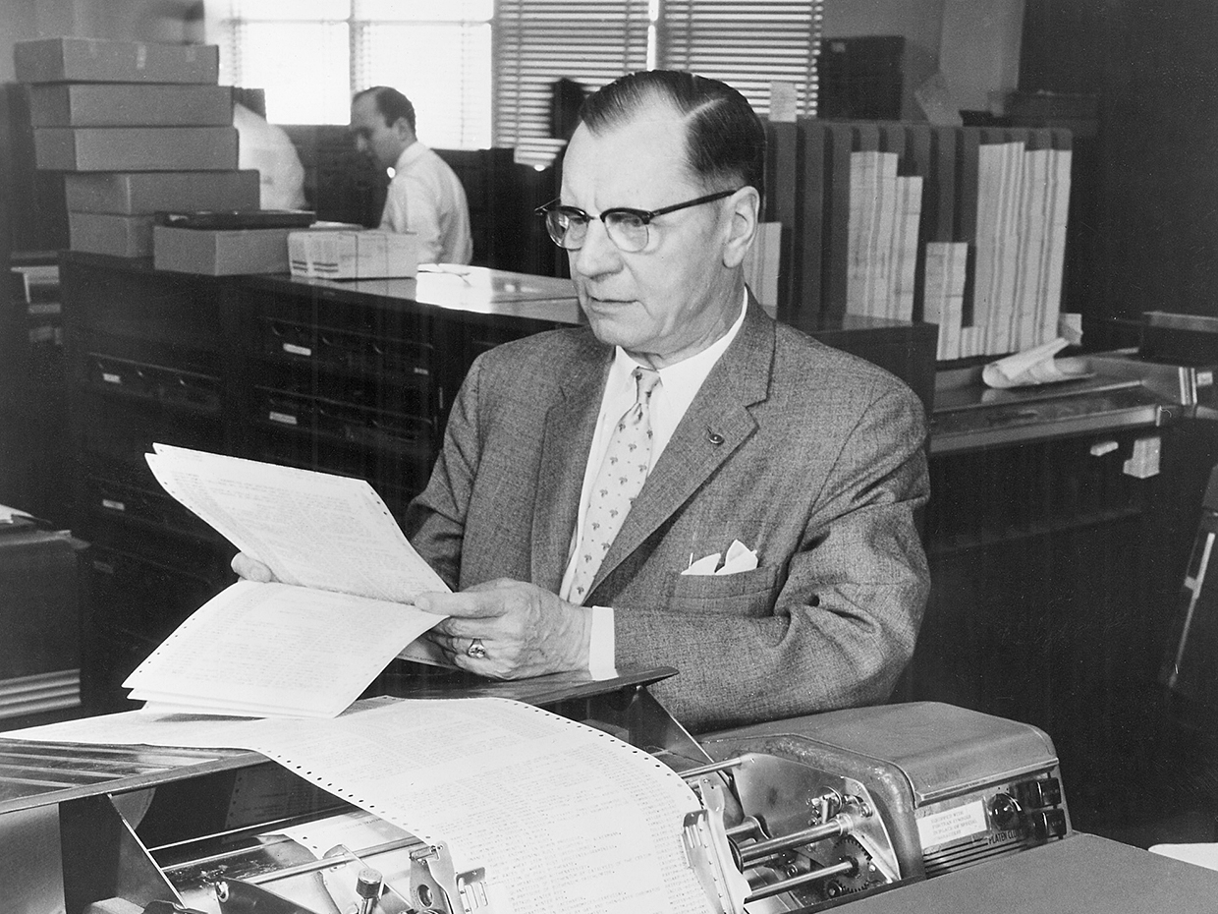
History of Luhn Algorithm
Invented by Hans Peter Luhn in 1954.
Luhn was a IBM researcher at the time.
Heavily based on modular arithmetic, a mathematical technique developed in the early 19th century by German mathematician Carl Friedrich Gauss.
Today, the algorithm is in the public domain and used broadly.
Hans Peter Luhn, Inventor

Slide 4

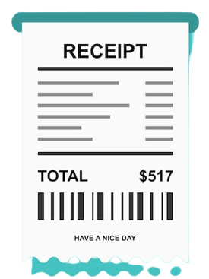


Luhn Algorithm Use Cases
IMEI
Credit Card Numbers
IMEI Numbers
Receipt Survey Codes
Social Security Numbers (SSN)
SIM Card Numbers

Slide 5





Who Uses Luhn Algorithm
VISA Credit Cards
Discover Credit Cards
US Government
Mastercard Credit Cards
American Express Credit Cards

Slide 6
How Does it Work?
Determining Check Digit for Valid Number
Start at the right end of the number. Multiply by 2 all digits of even rank in the number.
If the double of the digit is greater than 9, replace it with the sum of its digits.
Multiply by 1 all digits of odd rank from right to left in the number.
Sum up all of the digits found after completing the first two steps into a single sum, s.
Find the check digit in order to make to card number valid using formula, in which the check digit is determined by (10 - (s mod 10)) mod 10, where s is the sum from step 3 above.

Slide 7
How Does it Work?
Determining Validity of Known Card Number
Start at the right end of the number. Multiply all numbers with even rank by 2.
If the double of the digit is 10 or greater, replace it with the sum of its digits.
Multiply by 1 all digits of odd rank from right to left in the number.
Sum up all of the digits found after completing the first two steps into a single sum, s.
If s mod 10 == 0, then the number is valid. If it is not, the the card number is invalid.

Slide 8
Demonstration
4417 1234 5678 9113
(4 * 2) 4 (1*2) 7 (1*2) 2 (3*2) 4 (5*2) 6 (7*2) 8 (9*2) 1 (1*2) 3
8
2
2
6
10
14
18
2
1
5
9
sum = 70
70 mod 10 == 0
VALID

Slide 9

Drawbacks of Luhn Algorithm
The algorithm limits the detection of some sequences, so two differing inputs can have the same checksum.
It can only detect single digit errors, including the transpositions of adjacent numbers, but not double digit errors.
If 0s are in front of the start of the sequence or there are no zeros, it will not make a difference.

